Slide 1

Project Zero Website
By Donald Lopez

Slide 2
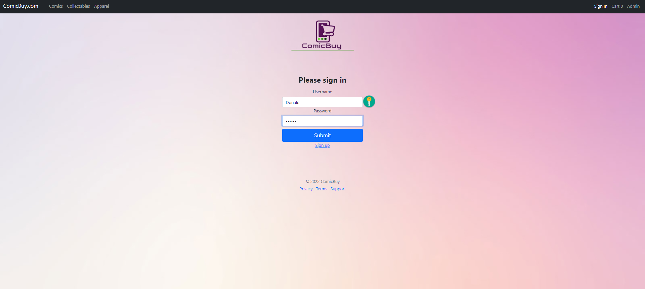
Welcome to my ComicBuy Website
This my login page kept it simple.

Slide 3
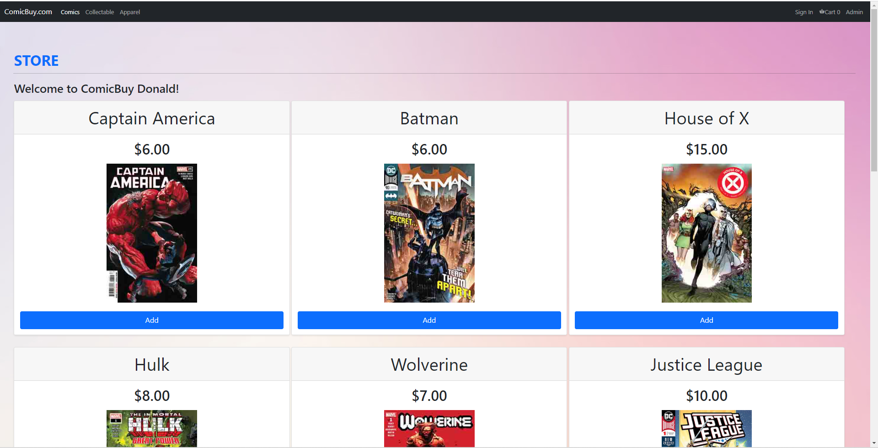
This is my Store at ComicBuy

Slide 4
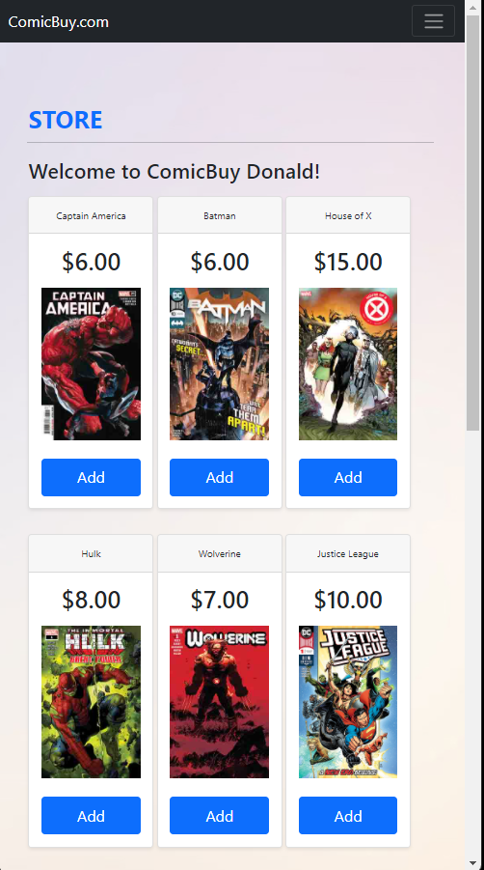
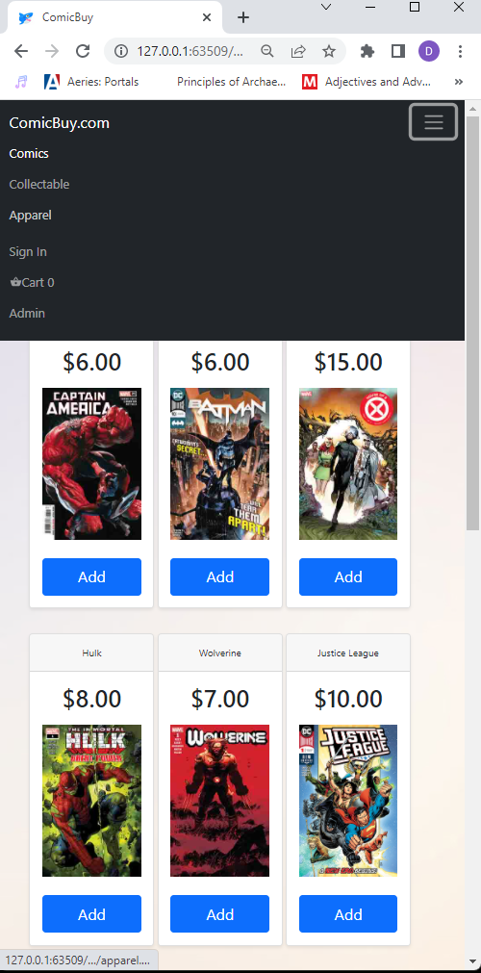
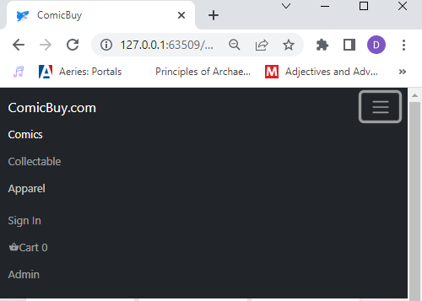

I made my Website Responsive
with a Dropdown Navbar
added a Favicon in my browser tab

Slide 5
Thank you for your attention

